Slide 1

50.039 Theory and Practice of Deep Learning W8-S3 Word Embedding Biases, Evaluation, Attention and Transformers
Matthieu De Mari

Slide 2
About this week (Week 8)
Why are embeddings an essential component of Neural Networks (NNs)?
Why are good embeddings difficult to produce?
What are the conventional approaches to embeddings in NLP? What can we learn from these approaches?
What are the typical issues with embeddings and how do we address them?
State-of-the-art of current embedding problems, and open questions in research.

Slide 3
About this week (Week 8)
How do we evaluate the quality/performance of an embedding?
Can embeddings be biased?
Can we help the neural networks identify the important parts of the context to focus on?
What is attention in Neural Networks? What are transformers in Neural Networks?
What are the typical uses for attention these days?
What are the limits of attention and the current research directions on this topic?

Slide 4
In the last episode…
We have discussed the embedding problem, and its aspects in Natural Language Processing. Many approaches have been used to improve the quality of word embeddings.
CBoW & SkipGram (2013),
GloVe (2014),
FastText (2018),
ELMo (2018).
Question: What makes a word embedding better than another? How do we measure the performance of an embedding?

Slide 5
Measuring Embeddings Performance
Evaluating the performance of an embedding is a difficult task and still an open question in research [Schnabel2015].
Reason: it is very difficult to come up with a performance measure to objectively evaluate the quality of a word embedding.
Overall, two big families of approaches:
Extrinsic methods
Intrinsic Methods

Slide 6
Measuring Embeddings Performance
Method #1 (Extrinsic Evaluation):
Methods of extrinsic evaluation are based on the ability of word embeddings to be used as the feature vectors of supervised machine learning algorithms.
The more able a word embedding is on a given (complex) task, the better it might be.
Typically, training a CBoW requires to predict a missing word, in the middle of a given sentence.
This is an easier task to train on, compared to predicting the possible context words for a given single word (SkipGram)
For this reason, we often assume that SkipGram > CBoW.

Slide 7
Measuring Embeddings Performance
In general, we train an embedding on a task and extract a layer from our Neural Network, corresponding to the embedding.
Extrinsic Evaluation: Evaluate the embedding by reusing it on another NLP benchmark task (using transfer learning).
Researchers have identified a set of typical NLP tasks and datasets on which we need word embeddings [Schnabel2015], e.g.
Sentiment Analysis
Translation
Etc.
These have often been used as reference for measuring the performance of a given word embedding.

Slide 8
Measuring Embeddings Performance
Method #2 (Intrinsic Evaluation):
Methods of intrinsic evaluation are experiments in which word embeddings are compared with human judgments on words relations.
Typically, we will rely on a human expert to judge whether the word embedding is good or not.

Slide 9
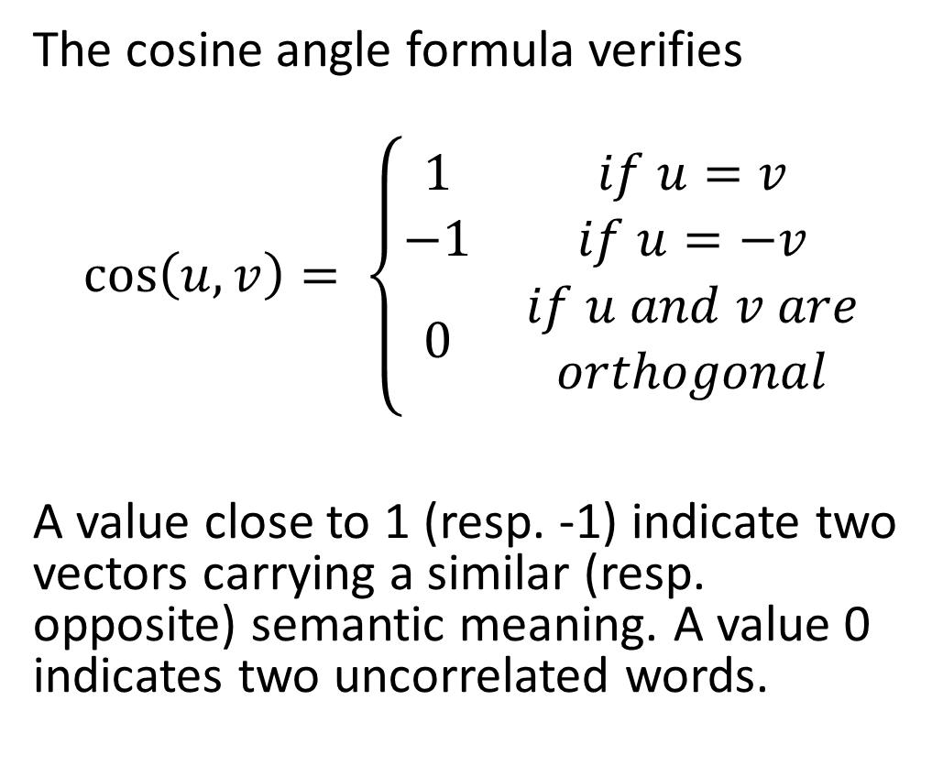
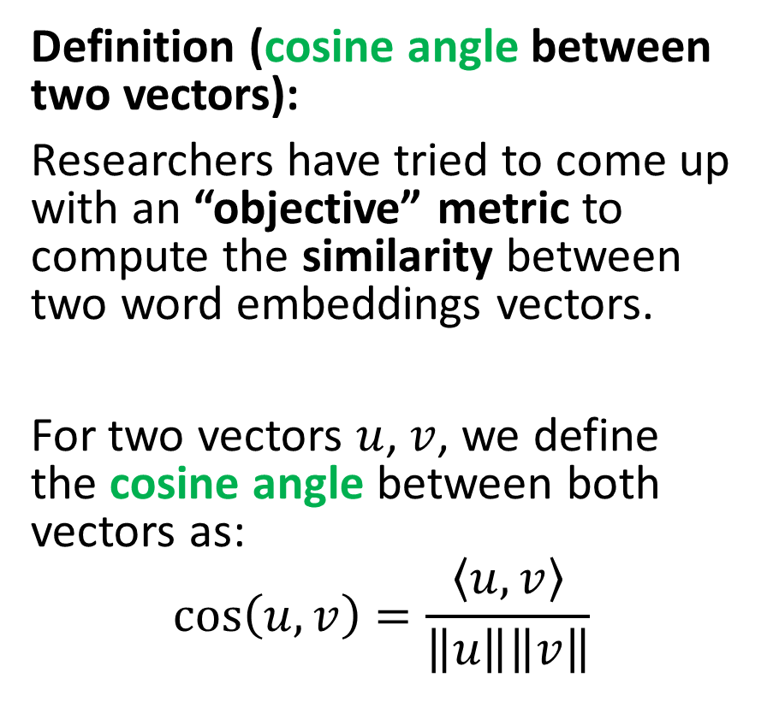
Measuring Embeddings Performance
Definition (cosine angle between two vectors):
Researchers have tried to come up with an “objective” metric to compute the similarity between two word embeddings vectors.
For two vectors $u$, $v$, we define the cosine angle between both vectors as:
$$\cos\left(u, v\right)=\frac{\left\langle u,v\right\rangle }{\left\|u\right\|\left\|v\right\|}$$
The cosine angle formula verifies
$$\cos\left(u,v\right)= \left\{\begin{matrix}1 & if u=v \\ −1 & if u=−v \\ 0 & \begin{aligned}if u and v are \\ orthogonal\end{aligned}\end{matrix}\right.$$
A value close to 1 (resp. -1) indicate two vectors carrying a similar (resp. opposite) semantic meaning. A value 0 indicates two uncorrelated words.

Slide 10
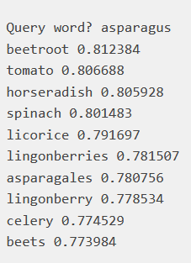
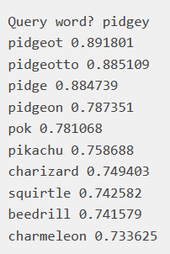
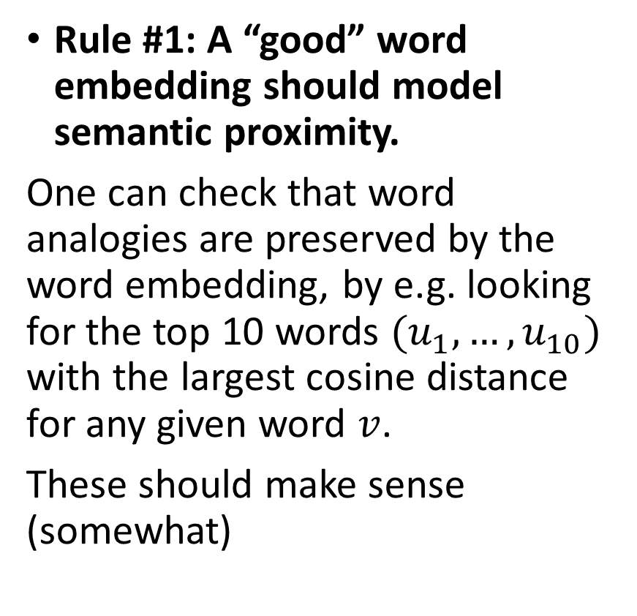
Measuring Embeddings Performance
Rule #1: A “good” word embedding should model semantic proximity.
One can check that word analogies are preserved by the word embedding, by e.g. looking for the top 10 words $(u_{1},…,u_{10})$ with the largest cosine distance for any given word $v$.
These should make sense (somewhat)
For instance (from the FastText tutorial https://fasttext.cc/docs/en/unsupervised-tutorial.html)

Slide 11

Measuring Embeddings Performance
Rule #1: A “good” word embedding should model semantic proximity.
One can check that word analogies are preserved by the word embedding, by e.g. looking for the top 10 words $(u_{1},…,u_{10})$ with the largest cosine distance for any given word $v$.
These should make sense (somewhat)
For instance (from the FastText tutorial https://fasttext.cc/docs/en/unsupervised-tutorial.html)
Are these top10 lists good or bad answers?
Your answer to this question will probably be very subjective and not a reliable performance evaluation metric...!

Slide 12
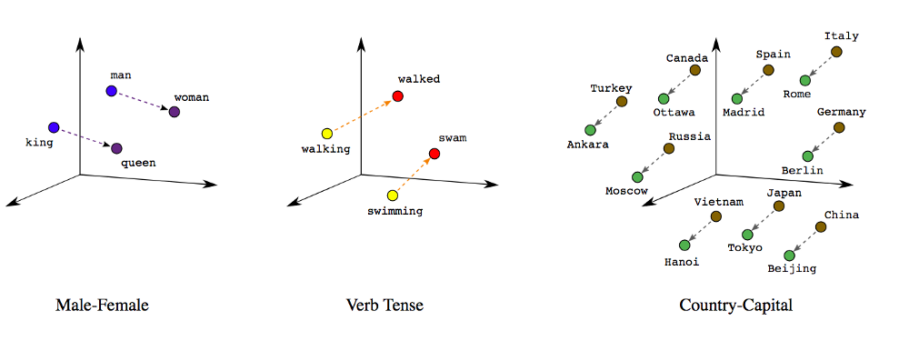
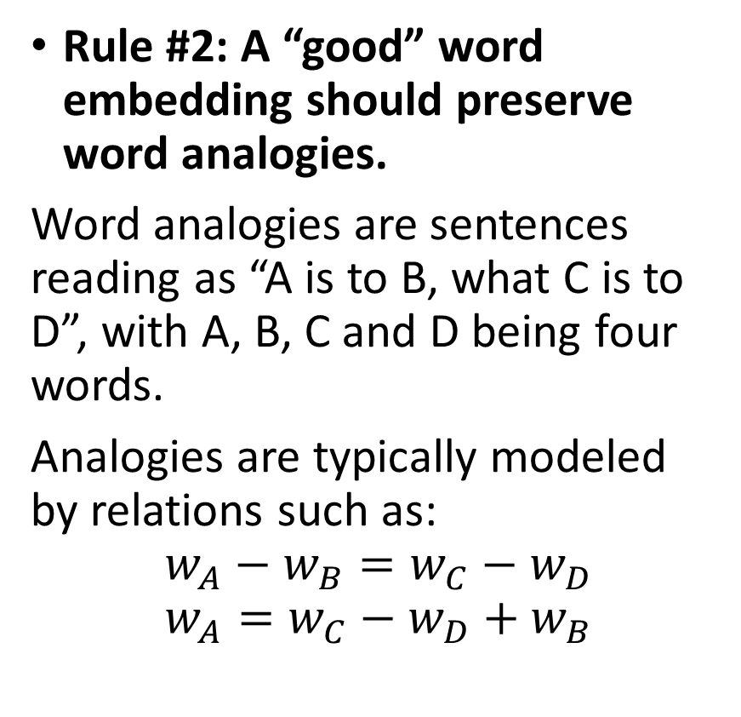
Measuring Embeddings Performance
Rule #2: A “good” word embedding should preserve word analogies.
Word analogies are sentences reading as “A is to B, what C is to D”, with A, B, C and D being four words.
Analogies are typically modeled by relations such as:
$$w_{A}−w_{B}=w_{C}−w_{D}$$
$$w_{A}=w_{C}−w_{D}+w_{B}$$

Slide 13
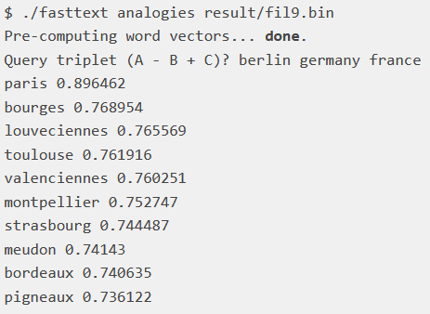

Measuring Embeddings Performance
Rule #2: A “good” word embedding should preserve word analogies.
Word analogies are sentences reading as “A is to B, what C is to D”, with A, B, C and D being four words.
Analogies are typically modeled by relations such as:
$$w_{A}−w_{B}=w_{C}−w_{D}$$
$$w_{A}=w_{C}−w_{D}+w_{B}$$
For instance (from the FastText tutorial https://fasttext.cc/docs/en/unsupervised-tutorial.html)
Is this top10 list containing good or bad answers?
Your answer to this question will (again!) probably be very subjective and not a reliable performance evaluation metric...!

Slide 14

Measuring Embeddings Performance
More specifically, because we are unsure what the word embedding values represent in terms of semantics.
There have been observed cases where the word embedding understands some “sort of relationship” but cannot properly distinguish between the different types of relationships, e.g.
$$w_{driver}−w_{car}=w_{king}−w_{queen}$$
Rule #2: A “good” word embedding should preserve word analogies.
Word analogies are sentences reading as “A is to B, what C is to D”, with A, B, C and D being four words.
Analogies are typically modeled by relations such as:
$$w_{A}−w_{B}=w_{C}−w_{D}$$
$$w_{A}=w_{C}−w_{D}+w_{B}$$
For instance (from the FastText tutorial https://fasttext.cc/docs/en/unsupervised-tutorial.html)
Is this top10 list containing good or bad answers?
Your answer to this question will (again!) probably be very subjective and not a reliable performance evaluation metric...!

Slide 15
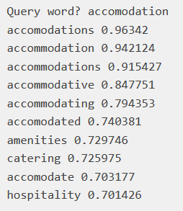
Measuring Embeddings Performance
Rule #3: A “good” word embedding should be able to operate on variations on the words (color/colour, typos, plural forms, conjugation, etc.).
For instance (from the FastText tutorial): https://fasttext.cc/docs/en/unsupervised-tutorial.html)
Is this top10 list containing good or bad answers?
Your answer to this question will (again!) probably be very subjective and not a reliable performance evaluation metric...!

Slide 16
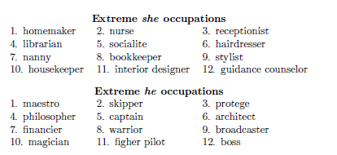
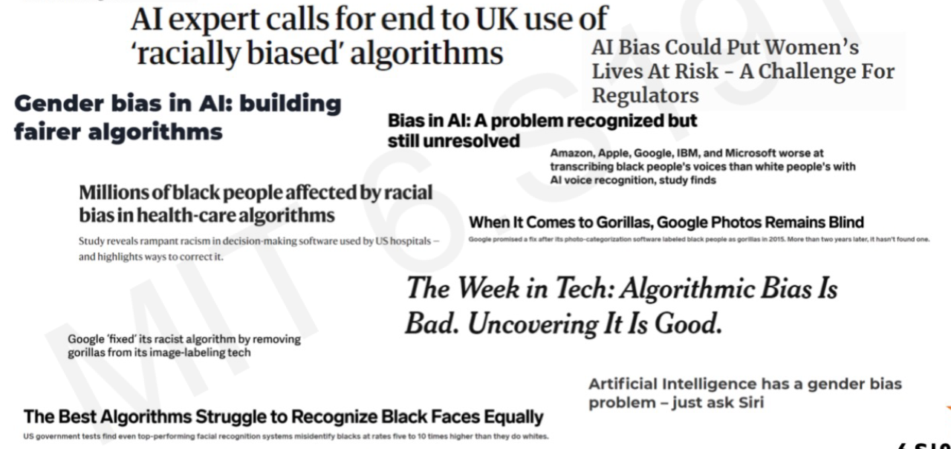

Word embedding biases
$$w_{man_job}−w_{man}+w_{woman}= ?$$
Important: A quick note on word embeddings biases.
As mentioned before, we value the quality of a word embedding by how good it manages to capture similarities and analogies between words, by extracting it from a given corpus.
Problem: if the corpus is biased (sexist, racist, etc.), it will catch these biases as well! (See [Bolukbasi2016]).

Slide 17
Word embeddings evaluation
Question: What makes a word embedding better than another?
How do we measure the performance of an embedding?
How do we decide on the best word embedding to use?
Answer: Still an open question at the moment…
No perfect qualitative method for evaluating Word Embeddings.
More of a “consensus”, which changes over the years.
Still a lot of work needed to come up with a “perfect” universal embedding (if that is even possible?)

Slide 18
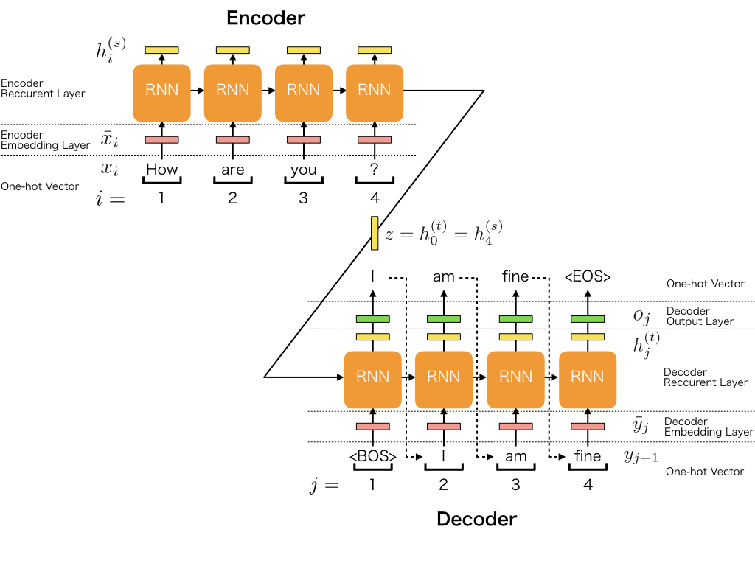
A reminder on sequence to sequence tasks
Definition (Seq2Seq):
A Sequence-to-Sequence task (Seq2Seq) is a family of machine learning tasks which turns an input sequence into another output sequence.
For instance, language to language translation (French sentence into an English sentence), answers to questions Chatbots, etc.

Slide 19
A reminder on sequence to sequence tasks
Definition (Encoder-Decoder architecture):
An Encoder-Decoder architecture typically consists of two parts:
An encoder, which converts a sequence into an embedding vector, presumably encapsulating the context of the sequence.
A decoder, which reads the embedding vector for context and constructs an output sequence.
Both the encoder and the decoder will be modeled as RNNs as they both operate on sequences.

Slide 20
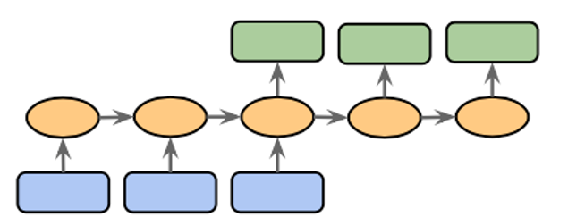
A reminder on sequence to sequence tasks
Definition (encoder and decoder models):
In general, the first part of the model will focus on analysing the input, eventually producing a final memory vector output after having seen all inputs. This is called an encoder.
Can be done with a RNN of some sort, where the final memory state consists of the encoding vector.
E.g. read an English sentence, progressively encoding each word’s meaning, to obtain the entire sentence meaning in a single encoding vector.

Slide 21
Encoder and Decoder models
Definition (encoder and decoder models):
In general, the second part of the model will focus on analysing the produced encoding vector and producing a sequence of some sort as output. This is called a decoder.
Can be done with the same (or another) RNN of some sort, where the first memory state consists of the encoding vector.
E.g. read an encoding vector describing an English sentence and produce an output sequence being the French translation.

Slide 22
Sequence to sequence tasks
In the classical Seq2Seq architecture,
a word embedding is used for each word of the sentence,
An (often bi-directional RNN) encoder is used to propagate and encode context among words in the sentence,
A decoder RNN reads the context vector and produces a new sentence.

Slide 23
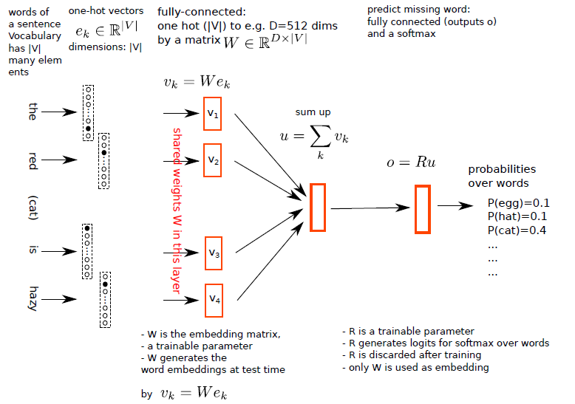
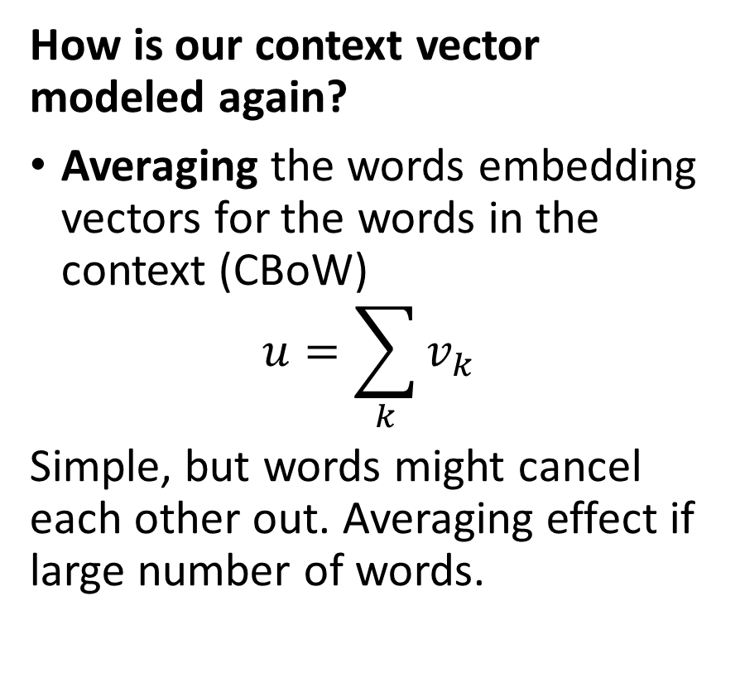
Sequence to sequence tasks
How is our context vector modeled again?
Averaging the words embedding vectors for the words in the context (CBoW)
$$u=\sum_{k}{v_{k}}$$
Simple, but words might cancel each other out. Averaging effect if large number of words.

Slide 24
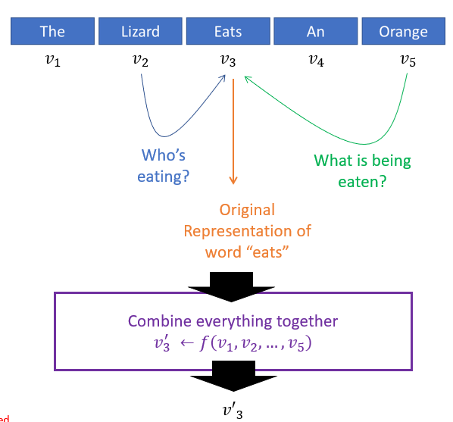
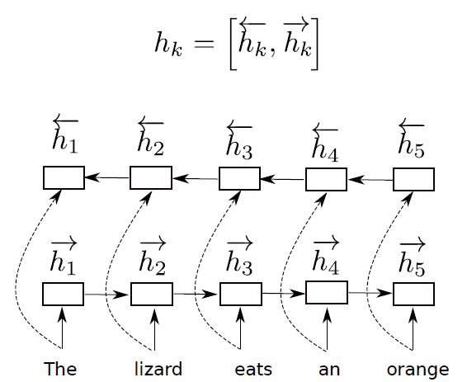
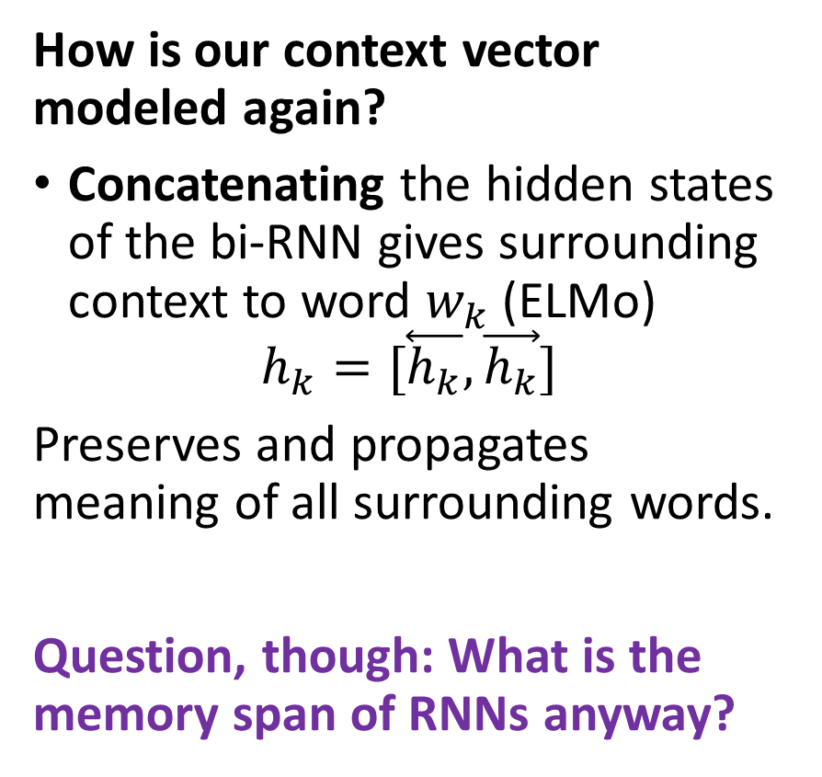
Sequence to sequence tasks
How is our context vector modeled again?
Concatenating the hidden states of the bi-RNN gives surrounding context to word $w_{k}$ (ELMo)
$$h_{k}=[\overset{⃖}{h_{k}},\vec{h_{k}}]$$
Preserves and propagates meaning of all surrounding words.
Question, though: What is the memory span of RNNs anyway?

Slide 25
Sequence to sequence tasks
How is our context vector modeled again?
Concatenating the hidden states of the bi-RNN gives surrounding context to word $w_{k}$ (ELMo)
$$h_{k}=[\overset{⃖}{h_{k}},\vec{h_{k}}]$$
Preserves and propagates meaning of all surrounding words.
Question, though: What is the memory span of RNNs anyway?

Slide 26
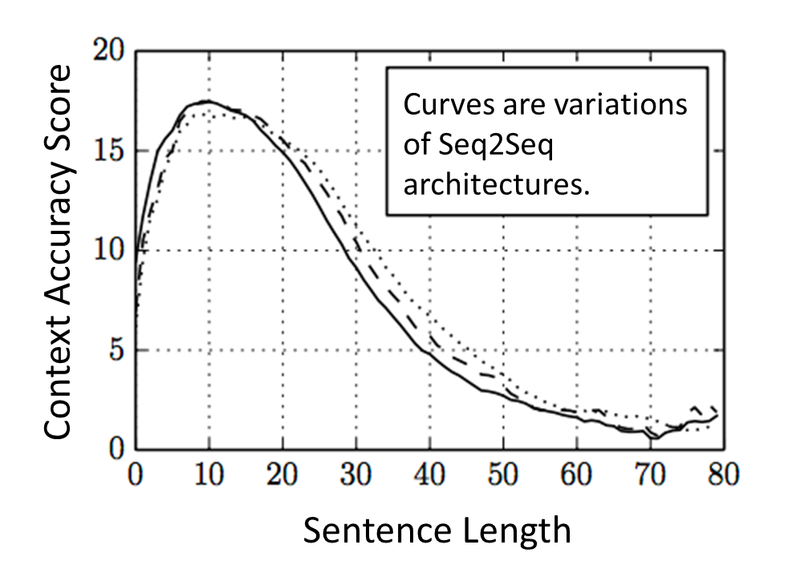
Sequence to sequence tasks
Question: What is the memory span of RNNs anyway?
Vanishing effect in memory between the successive hidden LSTM states if large number of words in sentence [Vaswani2017].
Your RNN will have forgotten about word #1 by the time you reach word #70.
→ Loss of context!
From: https://www.kaggle.com/sarthakvajpayee/attention-mechanism-japanese-english/notebook

Slide 27
Sequence to sequence tasks
What is the reason for the loss of context meaning in large sentences?
Words that are far away from each other will have their context lost by the hidden state of the LSTM RNN.
For instance,
“Paris was a universe whole and entire unto herself, hollowed and fashioned by history; so she seemed in this age of Napoleon III with her towering buildings, her massive cathedrals, her grand boulevards, and ancient winding medieval streets–as vast and indestructible as nature itself. All was embraced by her, by her volatile and enchanted populace thronging the galleries, the theaters, the cafes, giving birth over and over to genius and sanctity, philosophy and war, frivolity and the finest art; so it seemed that if all the world outside her were to sink into darkness, what was fine, what was beautiful, what was essential might there still come to its finest flower.“

Slide 28
Sequence to sequence tasks
What is the reason for the loss of context meaning in large sentences?
Words that are far away from each other will have their context lost by the hidden state of the LSTM RNN.
For instance,
“Paris was a universe whole and entire unto herself, hollowed and fashioned by history; so she seemed in this age of Napoleon III with her towering buildings, her massive cathedrals, her grand boulevards, and ancient winding medieval streets–as vast and indestructible as nature itself. All was embraced by her, by her volatile and enchanted populace thronging the galleries, the theaters, the cafes, giving birth over and over to genius and sanctity, philosophy and war, frivolity and the finest art; so it seemed that if all the world outside her were to sink into darkness, what was fine, what was beautiful, what was essential might there still come to its finest flower.“

Slide 29
Sequence to sequence tasks
What is the reason for the loss of context meaning in large sentences?
Words that are far away from each other will have their context lost by the hidden state of the LSTM RNN.
For instance,
“Paris was a universe whole and entire unto herself, hollowed and fashioned by history; so she seemed in this age of Napoleon III with her towering buildings, her massive cathedrals, her grand boulevards, and ancient winding medieval streets–as vast and indestructible as nature itself. All was embraced by her, by her volatile and enchanted populace thronging the galleries, the theaters, the cafes, giving birth over and over to genius and sanctity, philosophy and war, frivolity and the finest art; so it seemed that if all the world outside her were to sink into darkness, what was fine, what was beautiful, what was essential might there still come to its finest flower.“

Slide 30
Sequence to sequence tasks
What is the reason for the loss of context meaning in large sentences?
Words that are far away from each other will have their context lost by the hidden state of the LSTM RNN.
Question: Can we train our Neural Networks to get a better grasp of the important words that matter in the sequence and how to connect them, even when far away from each other?
Yes!
That is exactly what the attention layer does!

Slide 31
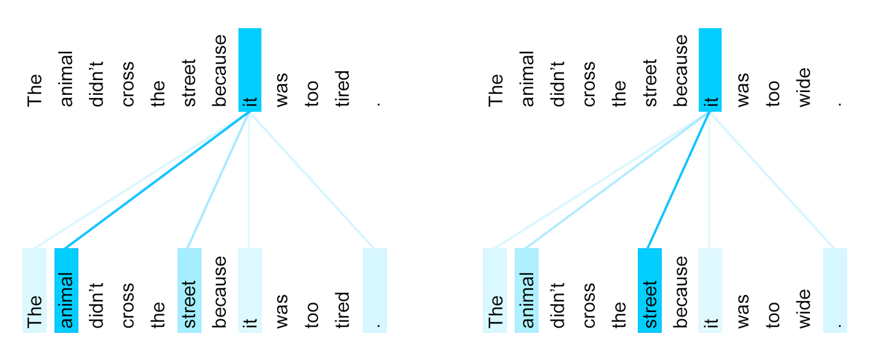
Attention: definition and motivation
Definition (attention):
In the context of neural networks, attention (as introduced in [Vaswani2017, Devlin2019]) is a technique that mimics cognitive attention.
The effect enhances the important parts of the input data and fades out the rest.
The thought being that the network should devote more computing power on that small but important part of the data.

Slide 32
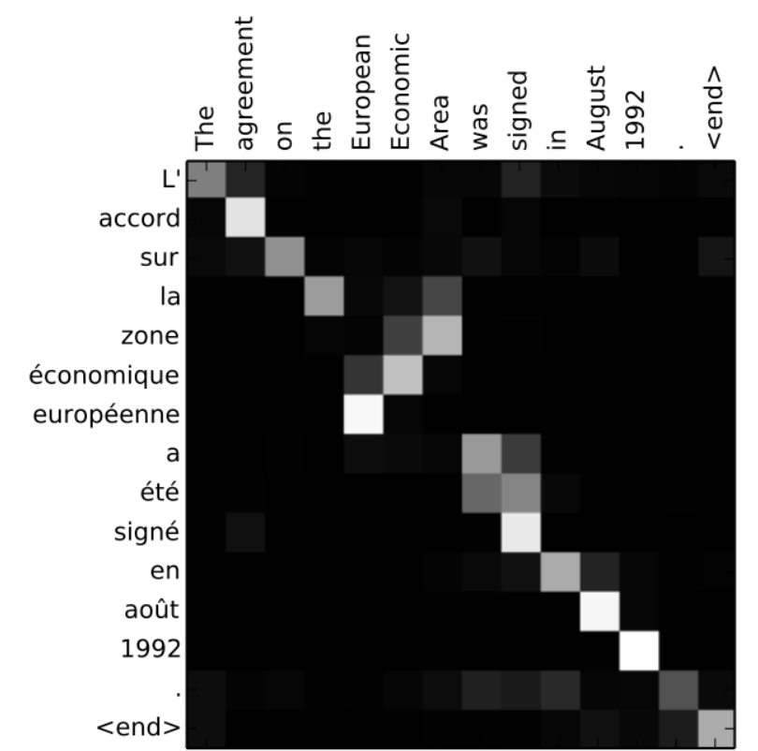
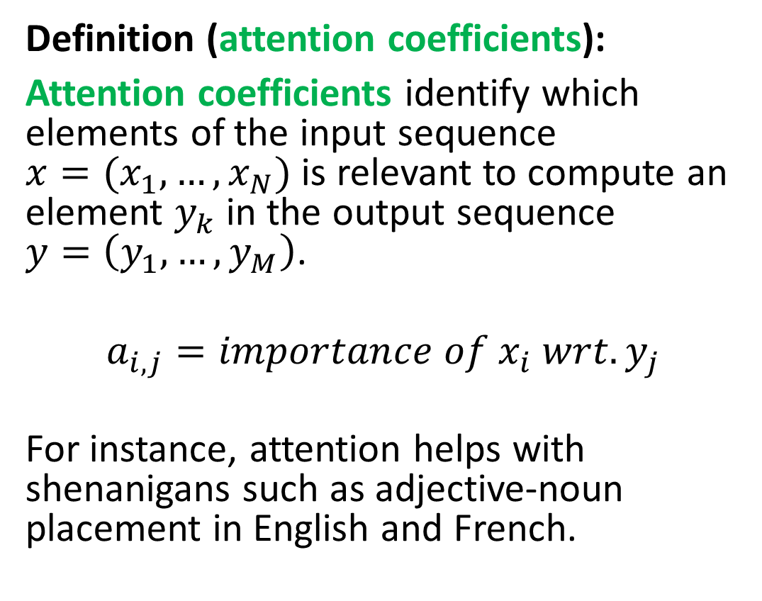
Attention coefficients
Definition (attention coefficients):
Attention coefficients identify which elements of the input sequence $x=(x_{1},…,x_{N})$ is relevant to compute an element $y_{k}$ in the output sequence $y=\left(y_{1},…,y_{M}\right)$.
$$a_{i,j}=importance of x_{i} wrt.y_{j}$$
For instance, attention helps with shenanigans such as adjective-noun placement in English and French.

Slide 33

Attention coefficients
“Paris was a universe whole and entire unto herself, hollowed and fashioned by history; so she seemed in this age of Napoleon III with her towering buildings, her massive cathedrals, her grand boulevards, and ancient winding medieval streets–as vast and indestructible as nature itself. All was embraced by her, by her volatile and enchanted populace thronging the galleries, the theaters, the cafes, giving birth over and over to genius and sanctity, philosophy and war, frivolity and the finest art; so it seemed that if all the world outside her were to sink into darkness, what was fine, what was beautiful, what was essential might there still come to its finest flower.“
Definition (attention coefficients):
Attention coefficients identify which elements of the input sequence $x=(x_{1},…,x_{N})$ is relevant to compute an element $y_{k}$ in the output sequence $y=\left(y_{1},…,y_{M}\right)$.
$$a_{i,j}=importance of x_{i} wrt. y_{j}$$
For instance, attention helps with shenanigans such as adjective-noun placement in English and French.

Slide 34
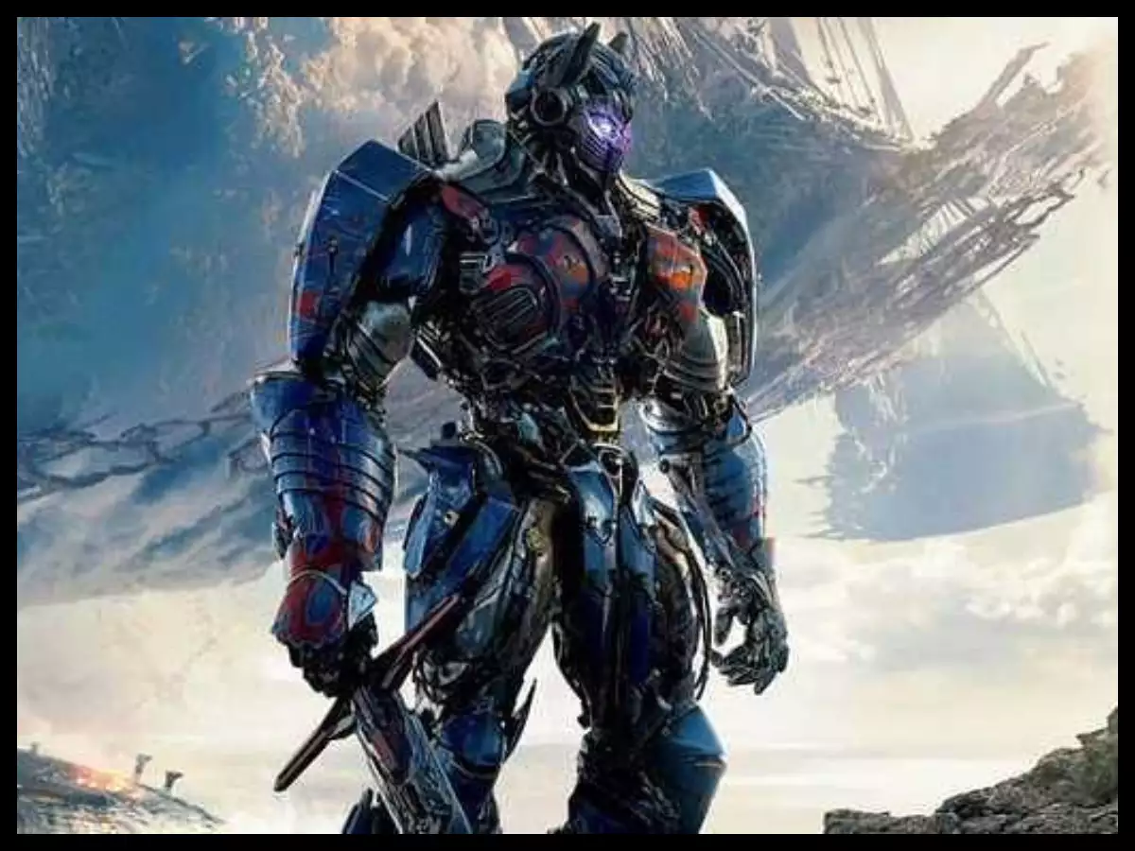
Attention: definition and motivation
Definition (transformer):
A transformer network make extensive use of attention mechanisms and more specifically attention layers to achieve their expressive power.
Transformers are currently considered as one of the most promising directions for Computer Vision, and Natural Language Processing.
Don’t you even think about it.
Seriously, don’t.

Slide 35
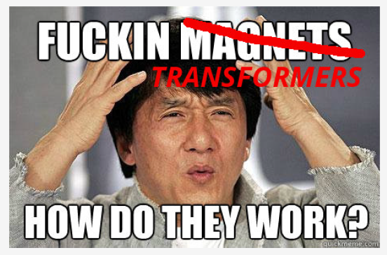
The attention layer
But first, a disclaimer from our beloved SUTD sponsor because transformers are, by far, the most difficult architecture we will see this term.
Definition (the transformer architecture):

Slide 36
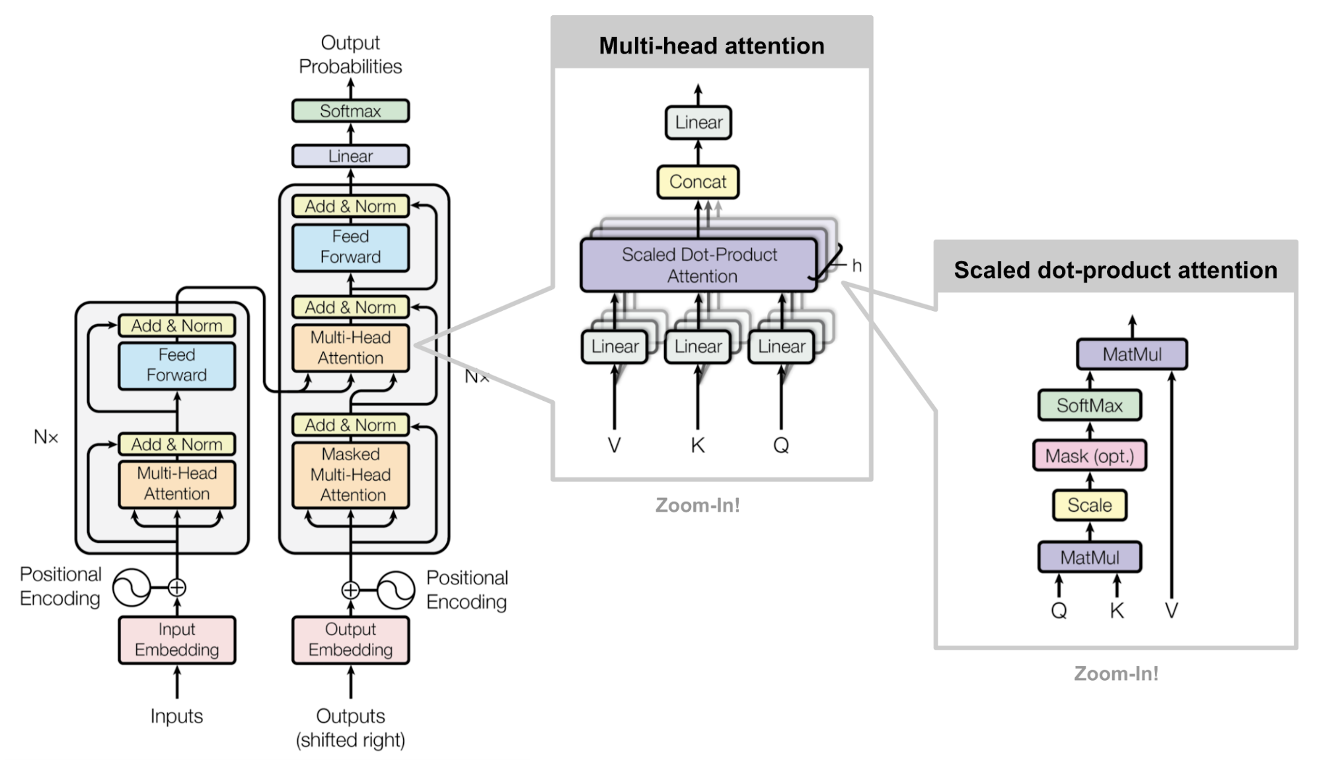

Slide 37
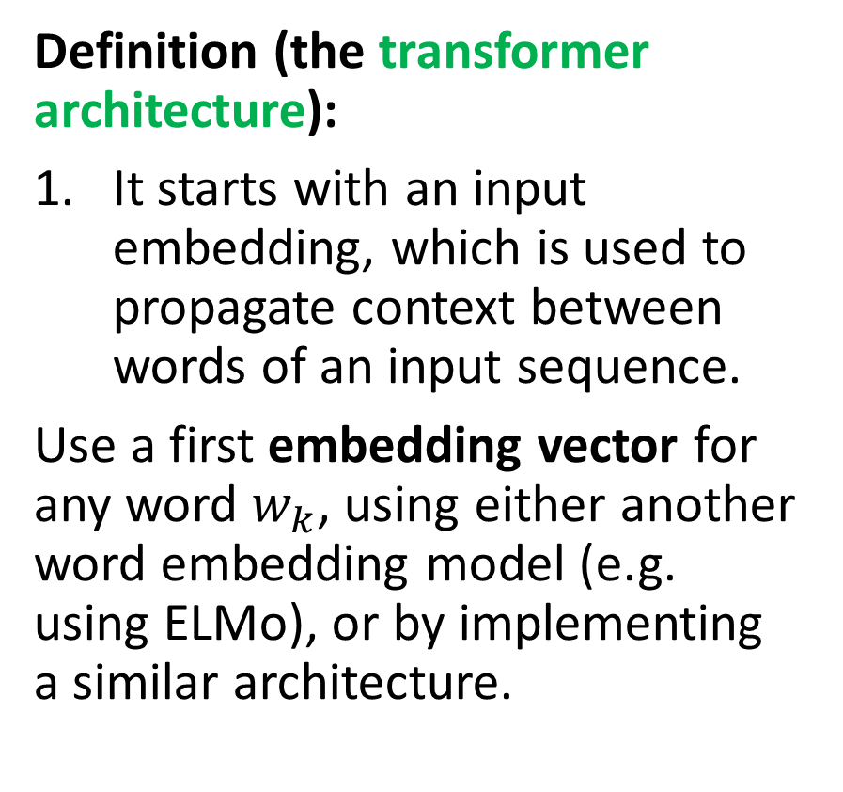
The attention layer
Definition (the transformer architecture):
It starts with an input embedding, which is used to propagate context between words of an input sequence.
Use a first embedding vector for any word $w_{k}$, using either another word embedding model (e.g. using ELMo), or by implementing a similar architecture.

Slide 39
The attention layer
Definition (the transformer architecture):
If you observe, the self-attention computations we will define later have no notion of the ordering of words among the sequences.
This is where positional encoding comes into play.
(However, out-of-scope for this class, will be skipped).
Core idea: Some languages have different positioning of words in sentences (Japanese tends to put verbs at the end of sentence, French tends to place adjectives after nouns, etc.)
To elicit this notion of positioning of words in the sequence, positional encoding can be added to the regular input embeddings.

Slide 41
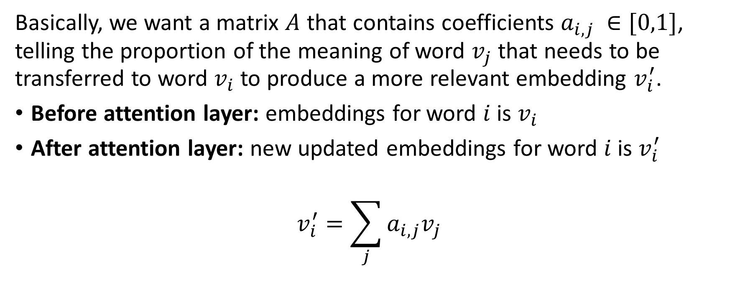
The attention layer
Basically, we want a matrix $A$ that contains coefficients $a_{i,j }∈[0,1]$, telling the proportion of the meaning of word $v_{j}$ that needs to be transferred to word $v_{i}$ to produce a more relevant embedding $v_{i}^{′}$.
Before attention layer: embeddings for word $i$ is $v_{i}$
After attention layer: new updated embeddings for word $i$ is $v_{i}^{′}$
$$v_{i}^{′}=\sum_{j}{a_{i,j}v_{j}}$$

Slide 42
The attention layer
Basically, we want a matrix $A$ that contains coefficients $a_{i,j }∈[0,1]$, telling the proportion of the meaning of word $v_{j}$ that needs to be transferred to word $v_{i}$ to produce a more relevant embedding $v_{i}^{′}$.
Before attention layer: embeddings for word $i$ is $v_{i}$
After attention layer: new updated embeddings for word $i$ is $v_{i}^{′}$
$$v_{i}^{′}=\sum_{j}{a_{i,j}v_{j}}$$

Slide 43
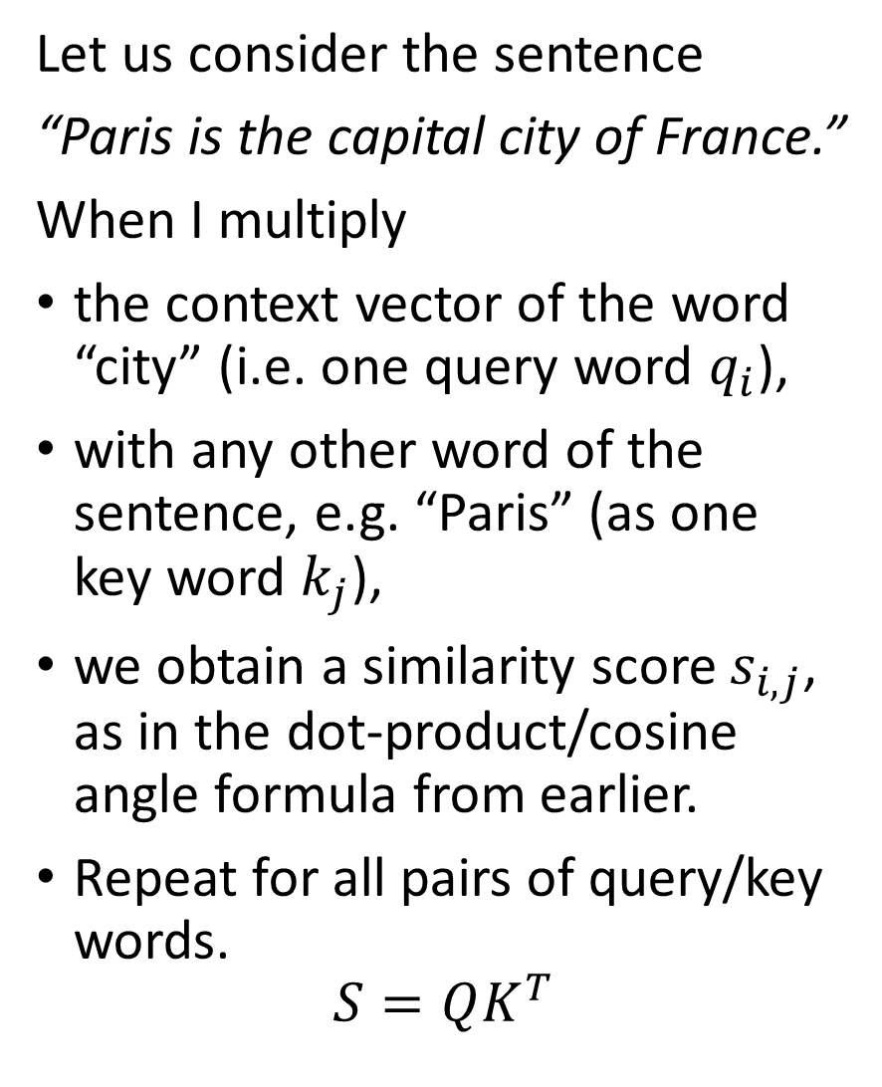
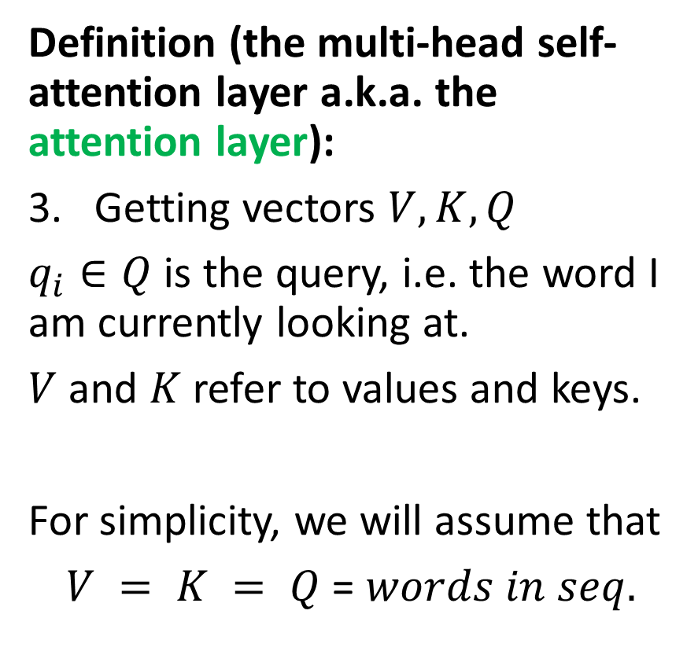
The attention layer
Let us consider the sentence
“Paris is the capital city of France.”
When I multiply
the context vector of the word “city” (i.e. one query word $q_{i}$),
with any other word of the sentence, e.g. “Paris” (as one key word $k_{j}$),
we obtain a similarity score $s_{i,j}$, as in the dot-product/cosine angle formula from earlier.
Repeat for all pairs of query/key words.
$$S=QK^{T}$$
Definition (the multi-head self-attention layer a.k.a. the attention layer):
Getting vectors $V, K, Q$
$q_{i}∈Q$ is the query, i.e. the word I am currently looking at.
$V$ and $K$ refer to values and keys.
For simplicity, we will assume that
$V = K = Q$ = $words in seq.$

Slide 45
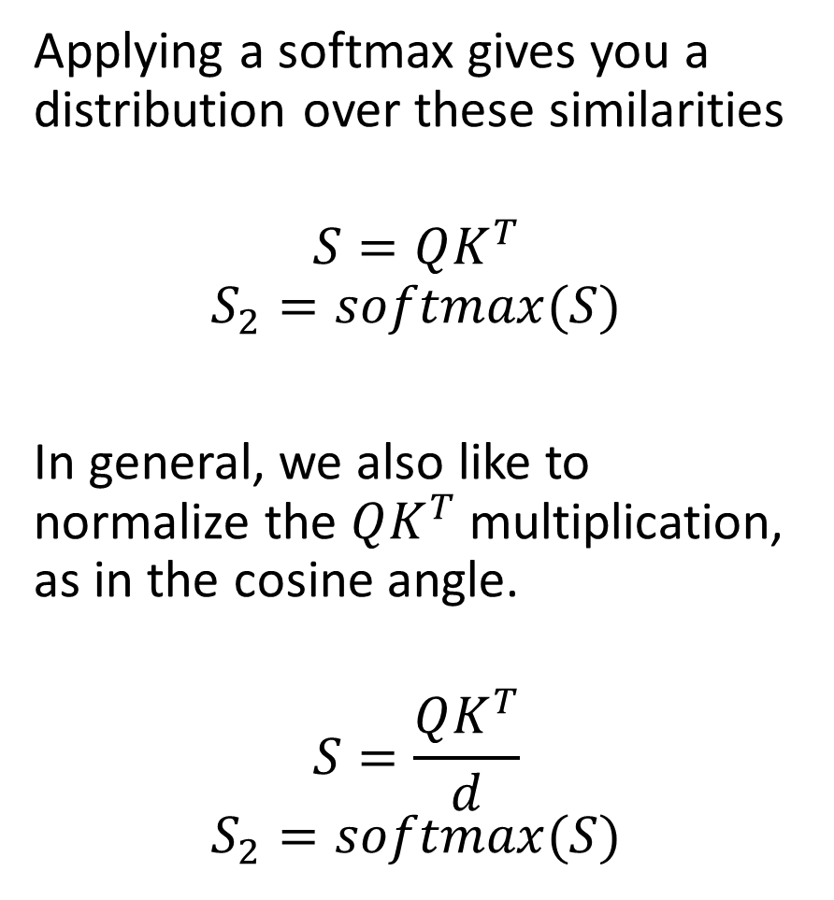
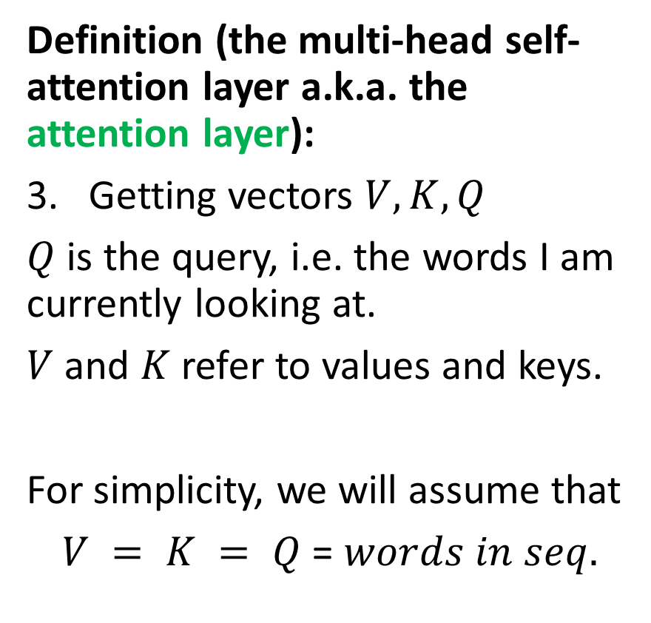
The attention layer
Applying a softmax gives you a distribution over these similarities
$$S=QK^{T}$$
$$S_{2}=softmax(S)$$
In general, we also like to normalize the $QK^{T}$ multiplication, as in the cosine angle.
$$S=\frac{QK^{T}}{d}$$
$$S_{2}=softmax(S)$$
Definition (the multi-head self-attention layer a.k.a. the attention layer):
Getting vectors $V, K, Q$
$Q$ is the query, i.e. the words I am currently looking at.
$V$ and $K$ refer to values and keys.
For simplicity, we will assume that
$V = K = Q$ = $words in seq.$

Slide 46
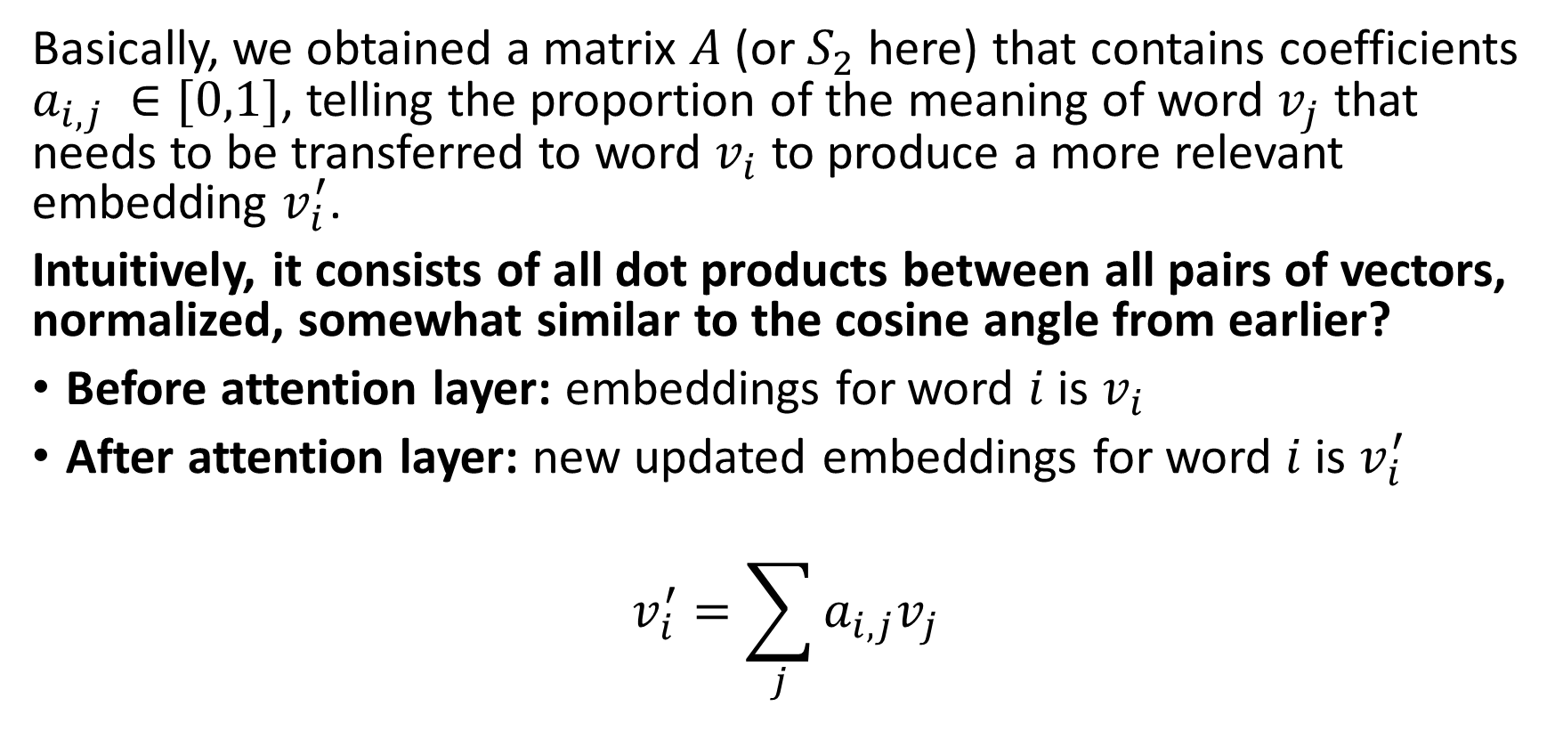
The attention layer
Basically, we obtained a matrix $A$(or $S_{2}$here) that contains coefficients $a_{i,j }∈[0,1]$, telling the proportion of the meaning of word $v_{j}$ that needs to be transferred to word $v_{i}$ to produce a more relevant embedding $v_{i}^{′}$.
Intuitively, it consists of all dot products between all pairs of vectors, normalized, somewhat similar to the cosine angle from earlier?
Before attention layer: embeddings for word $i$ is $v_{i}$
After attention layer: new updated embeddings for word $i$ is $v_{i}^{′}$
$$v_{i}^{′}=\sum_{j}{a_{i,j}v_{j}}$$

Slide 47
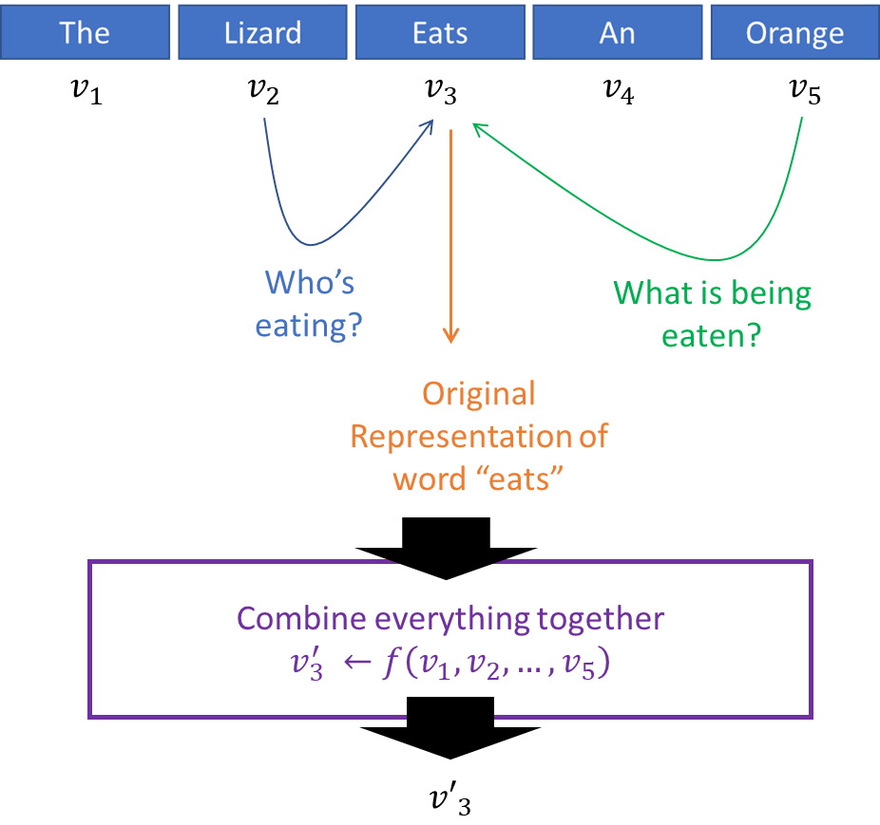

Slide 48
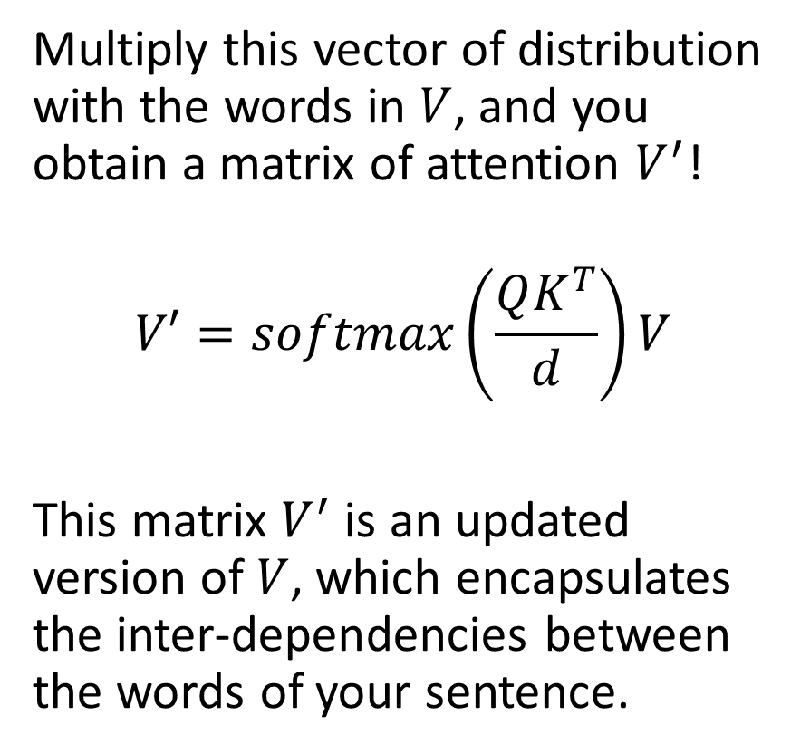
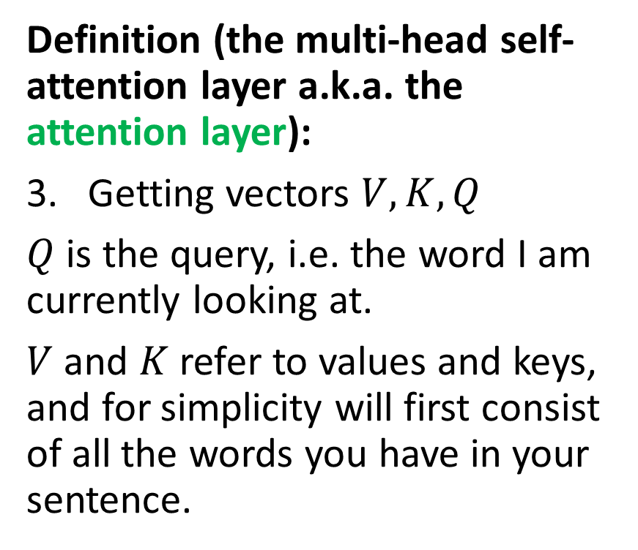
The attention layer
Definition (the multi-head self-attention layer a.k.a. the attention layer):
Getting vectors $V, K, Q$
$Q$ is the query, i.e. the word I am currently looking at.
$V$ and $K$ refer to values and keys, and for simplicity will first consist of all the words you have in your sentence.
Multiply this vector of distribution with the words in $V$, and you obtain a matrix of attention $V^{′}$!
$$V′=softmax\left(\frac{QK^{T}}{d}\right)V$$
This matrix $V^{′}$ is an updated version of $V$, which encapsulates the inter-dependencies between the words of your sentence.

Slide 49
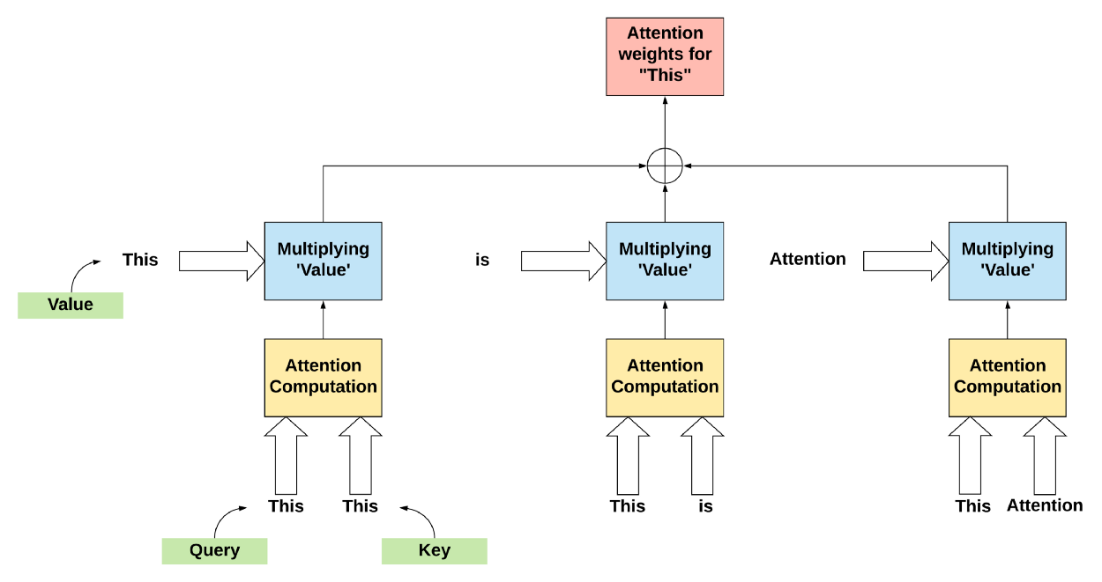

Slide 50
The attention layer
Definition (the multi-head self-attention layer a.k.a. the attention layer):
Getting vectors $V, K, Q$
$Q$ is the query, i.e. the words I am currently looking at.
$V$ and $K$ refer to values and keys.
For simplicity, we will assume that
$V = K = Q$ = $words in seq.$
This calculation is often referred to as self-attention, as it gives inter-dependencies between the words of a single sentence.

Slide 51
V, K and Q are the same here

Slide 53
The attention layer
Definition (the multi-head self-attention layer a.k.a. the attention layer):
Masking is only used in the decoder part (and it will be discussed later).

Slide 55
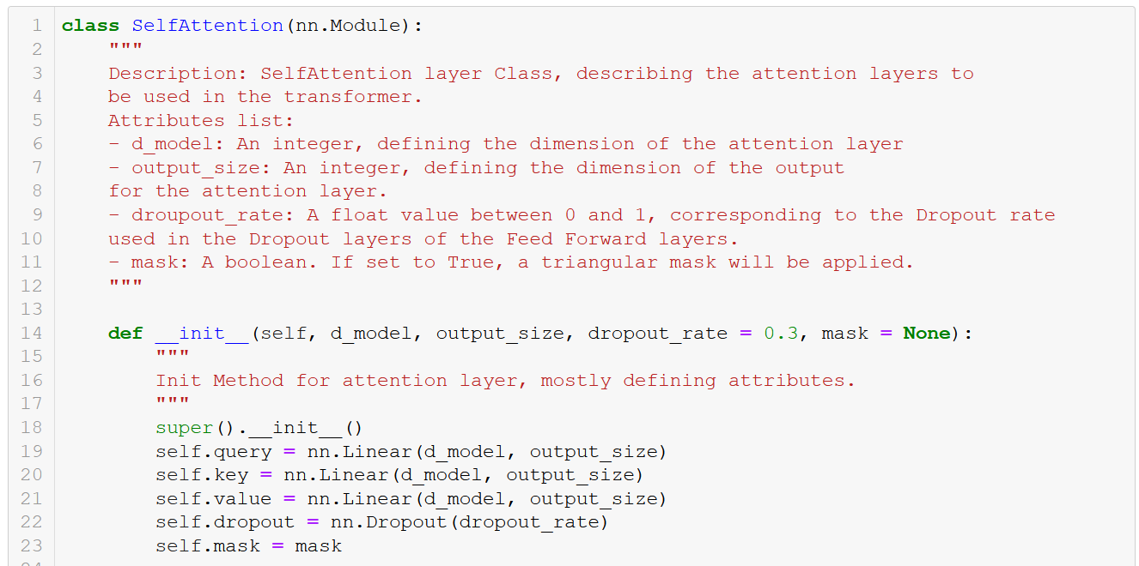

Slide 56
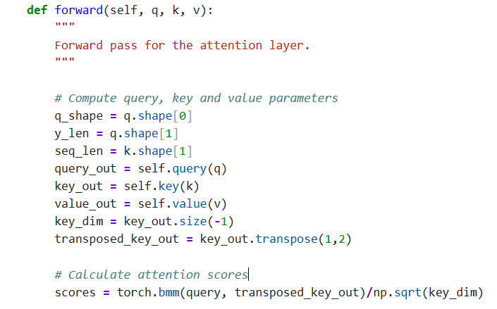
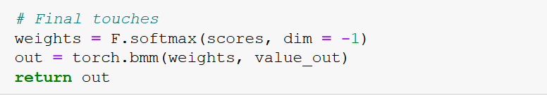
(masking part to be discussed later)

Slide 57
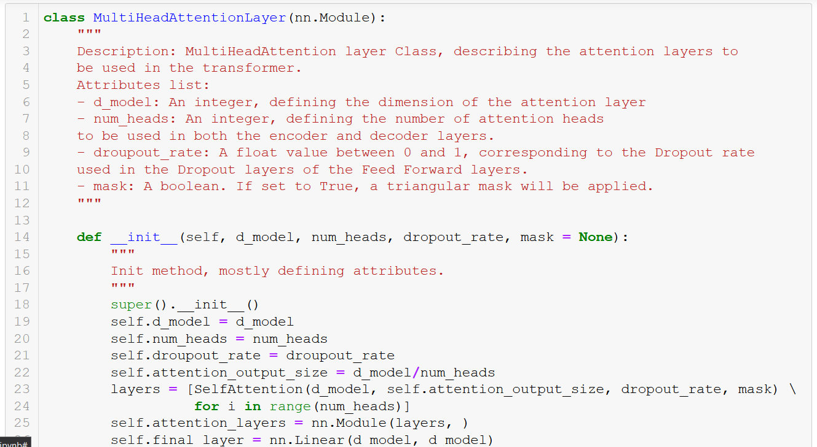

Slide 58
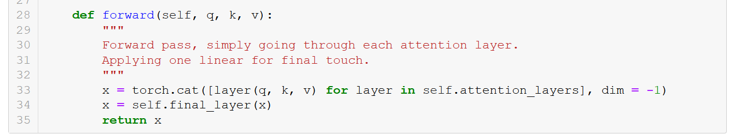

Slide 59
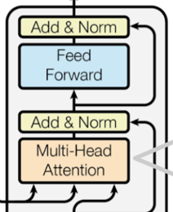
The attention layer
Definition (the multi-head self-attention layer a.k.a. the attention layer):
Feedforward is a set of linear/fully connected layers, whose main purpose is to allow for smooth transitions and reshape the attention vectors so that it is acceptable by the next encoder or decoder layer.
Also uses a skip/residual connection as in ResNet!

Slide 60
ONE ENCODER LAYER

Slide 61
FULL
ENCODER

Slide 62
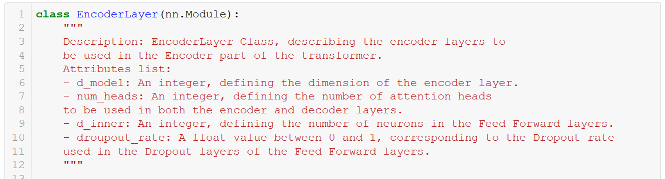

Slide 63
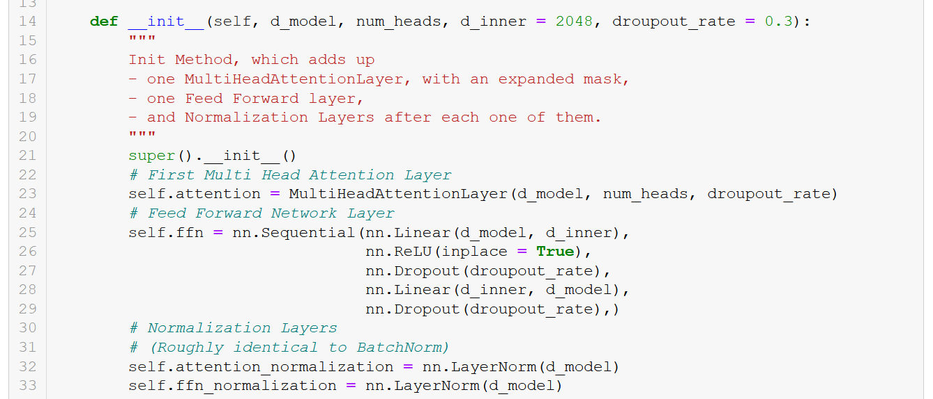

Slide 64
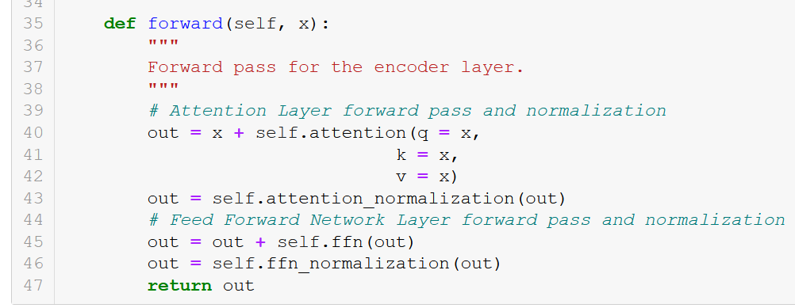

Slide 65
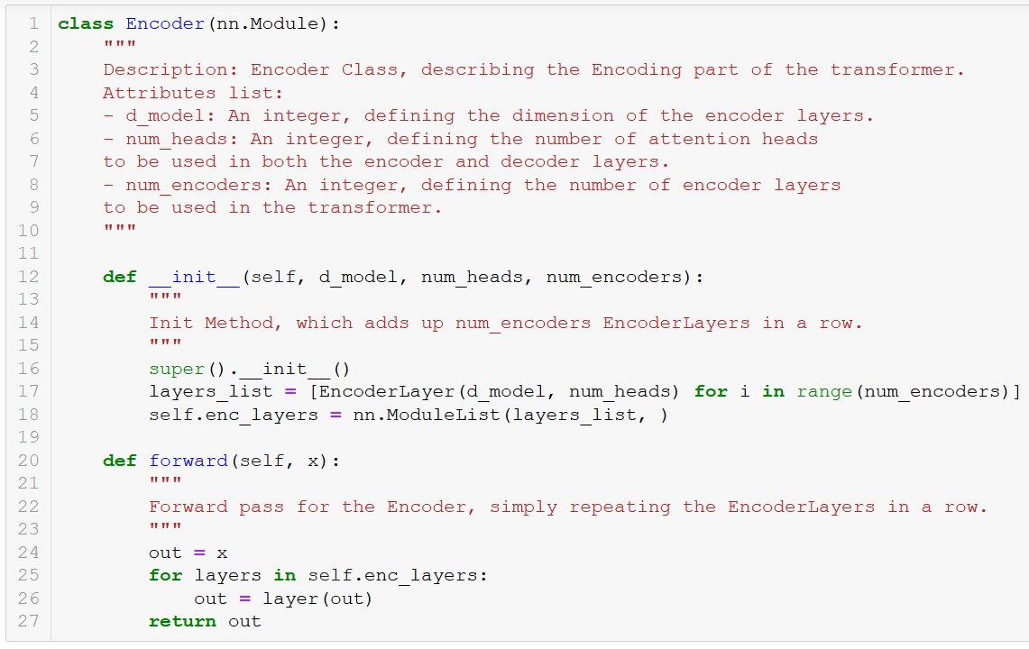

Slide 66
DECODER
But wait, what are the outputs doing here?

Slide 67
The attention layer
Important question: Why are the outputs used both as inputs and targets for the decoder model?
Our objective is to train a good word embedding (our encoder), by using an encoder-decoder architecture on some NLP task.
At the end of the day, the performance of this Seq2Seq model is irrelevant, as we only care about the embedding (as in SkipGram).
So, who cares if we “cheat” and give the answer to the decoder model?

Slide 68
DECODER

Slide 69
The attention layer
While generating target sequences at the decoder, since the transformer uses self-attention, it tends to include all the words from the decoder inputs. But, practically, this is incorrect and too much “cheating” for the network.
The transformer must not use the current or future output to predict the next one, so the output sequence must be partially masked to prevent this reverse information flow.
Masking Multi-Head Attention ensures this.
Definition (the multi-head self-attention layer a.k.a. the attention layer):
Same multi-head block as before but with masking this time! Why masking?

Slide 70
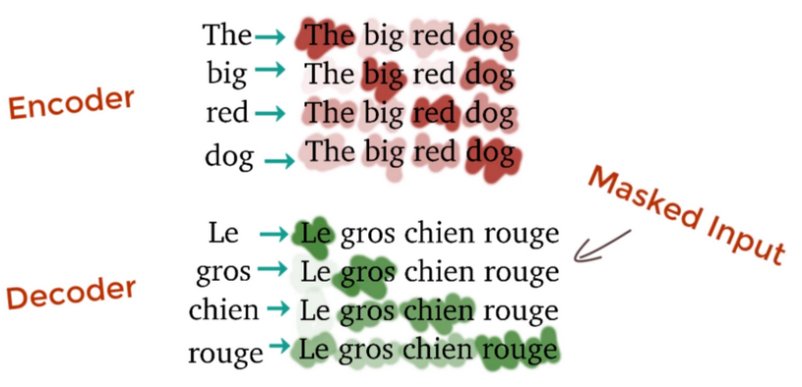
The attention layer
Definition (the multi-head self-attention layer a.k.a. the attention layer):
Same multi-head block as before but with masking this time! Why masking?
While generating target sequences at the decoder, since the transformer uses self-attention, it tends to include all the words from the decoder inputs.
But, practically this is incorrect. Only the words preceding the current word may contribute to the generation of the next word.
Masked Multi-Head Attention ensures this.

Slide 71

(Extra step in the attention layer class, forward method!)
Note: I played around with a few different masks, just for fun. Paper suggests to use the triu (upper triangular) mask.

Slide 72
DECODER BLOCK!

Slide 73

The attention layer
Definition (the multi-head self-attention layer a.k.a. the attention layer):
The second attention block is special as it uses $V$ and $K$ vectors from the encoder part and vectors $Q$ from the decoder part.
$$A=softmax\left(\frac{QK^{T}}{d}\right)V$$

Slide 74
The attention layer
Definition (the multi-head self-attention layer a.k.a. the attention layer):
Repeat the attention block (multi-head attention + add/norm + feed forward) a few times.
Finish with a fully connected and softmax giving probabilities for the words in each position of the output sequence!

Slide 75


Slide 76


Slide 77


Slide 78


Slide 79

The attention layer
Definition (the multi-head self-attention layer a.k.a. the attention layer):
Train it with a dataset consisting of several pairs $(x,y)$of sentences.
For instance, chatbot with $x$ being question prompts and $y$ being expected answers.
Or translation with $x$ and $y$ being sentences in two different languages.
Etc.

Slide 80
Time to assemble everything!

Slide 81


Slide 82



Slide 83
And, done!
Phew, that was a lot!

Slide 84

Well, at the end of the day, it is “just” matrix multiplications…

Slide 85

Great news!
The 2022 release of PyTorch COMES WITH TRANSFORMERS CLASSES!
https://pytorch.org/docs/stable/generated/torch.nn.Transformer.html

Slide 86
Applications for attention/transformers
In NLP: Sentences are typical examples of sequences where computing attention coefficients make sense as a way to help with contextualization.
Other applications for attention exist, typically with images, where attention coefficients can help understand how pixels interact with each other! Technically attention layers could “replace” CNNs!
Or how pixels could affect a caption decision (image and video captioning, handwritten recognition, etc.)
Will also be used in graphs next week!

Slide 87

The BERT word embedding
Why discuss transformers during this (long) lecture on embeddings?
Well, let us assume we train a transformer for a meaningless linguistics task…
Can we extract the encoder part, as we did with all the unsupervised approaches to word embedding (CBoW, SkipGram, FastText, ELMo)?
Yes! And you obtain one of the current best word embeddings, BERT (and its close cousin GPT)! [Devlin2019]
Python package: https://pypi.org/project/bert-embedding/

Slide 88

Also, GPT-n embeddings
On another note, OpenAI became famous because it produced an important competitor embedding, also relying on transformers, called GPT-3 [Brown2020][GPT-3].
GPT, being the acronym for Generative Pretrained Transformer.
Very similar to BERT, it is also considered one of the current state-of-the-art embeddings.

Slide 89
GPT3 and ChatGPT
In fact, GPT3 (and even 5.X these days!) is the encoder model that is used in ChatGPT to process the text prompt you have entered!
This encoding vector is later passed to a decoder, whose objective is to produce an answer to your text prompt, in the form of a text sequence!
Moving closer and closer to understanding ChatGPT fully, but more concepts are needed for the decoder part!
(Something for later, maybe W13!)

Slide 90


Transformers on HuggingFace
Definition (Hugging Face):
Hugging Face is a machine learning company that provides tools, models, and libraries designed to make natural language processing (NLP) and other machine learning tasks more accessible.
Widely used in both academia and industry to simplify the process of working with models, especially those based on transformers.

Slide 91

Implementing transformers on HuggingFace
In Notebook 5, we show how to implement a BERT word embedding using HuggingFace.
It consists of downloading and using a pre-trained model. (Often advised if you need a word embedding, training one is tough)
It includes a tokenizer and a word embedding model.

Slide 92
About tokenizers and models
Definition (Tokenizer):
IN NLP, a tokenizer is responsible for preprocessing text input so it can be understood by the model. The tokenizer will typically:
Split the input text into smaller units called "tokens." This breaks down words into tokens or word pieces (e.g., "unhappiness" will decompose into the tokens ["un", "happy", "ness"]).
Add special tokens such as separators (to separate sentences, convert special symbols or mark the end of a sequence).
Convert tokens into numerical IDs based on the model's vocabulary.
Tokenizers will be explored more in detail in the Term 7 NLP course.

Slide 93


Implementing transformers on HuggingFace
Later on, we can use our pre-trained BERT model to produce word embeddings.
We can also confirm that the BERT word embeddings preserve semantic similarity using the cosine similarity function!
(Feel free to use it for projects!)

Slide 94
On the limits of attention and what’s next?
Biggest limit of transformers: Computational costs when scaling to large models becomes problematic (→ GPU buying frenzy!)
Active research following the BERT and GPT embeddings, wondering what might be the next big revolution, that will address the limits and inductive biases of attention layers? ([Devlin2019])
Recent works tend to explore alternative types of transformer layers, e.g. the Lambda layers [Bello2021] or more recently the Continuous Thought Machines [CTM2025].
Still unclear!

Slide 95
Conclusion (W8S3)
We have seen a few approaches to embeddings.
Train an AI to figure out embeddings?
Basic approaches.
Out of dictionary entries?
Use ELMo or FastText!
(Alternative supervised methods?)
(Supervised: InferSent)
(Multi-task: Google’s Universal Embedding.)
A few more problems are still open at the moment for these word embeddings.
Can these embedding be biased? Yes, unfortunately, active research on this.
Can we help the network in computing context? Yes, with attention and transformers!
Best word embedding at the moment? Probably GPT4!

Slide 96
Learn more about these topics
Out of class, for those of you who are curious
[Schnabel2015] Schnabel et al., “Evaluation methods for unsupervised word embeddings”, 2015. https://www.aclweb.org/anthology/D15-1036/
[Bolukbasi2016] Bolukbasi et al., “Man is to Computer Programmer as Woman is to Homemaker? Debiasing Word Embeddings”, 2016. https://arxiv.org/abs/1607.06520
[Vaswani2017] Vaswani et al., “Attention Is All You Need”, 2017. https://arxiv.org/abs/1706.03762

Slide 97
Learn more about these topics
Out of class, for those of you who are curious
[Conneau2018] Conneau et al., “Supervised Learning of Universal Sentence Representations from Natural Language Inference Data”, 2018. https://arxiv.org/abs/1705.02364
[Cer2019] Cer et al., “Universal Sentence Encoder”, 2019. https://arxiv.org/abs/1803.11175
[Wang2018] Wang et al., “GLUE: A Multi-Task Benchmark and Analysis Platform for Natural Language Understanding” https://arxiv.org/abs/1804.07461

Slide 98
Learn more about these topics
Out of class, for those of you who are curious
[Devlin2019] Devlin et al., “BERT: Pre-training of Deep Bidirectional Transformers for Language Understanding”, 2019. https://arxiv.org/abs/1810.04805
[Brown2020] Brown et al. (20 of them or so), “Language Models are Few-Shot Learners”, 2020. https://arxiv.org/abs/2005.14165

Slide 99
Learn more about these topics
Out of class, for those of you who are curious
[Dong2021] Dong et al., “Attention is Not All You Need: Pure Attention Loses Rank Doubly Exponentially with Depth”, 2021. https://arxiv.org/abs/2103.03404
[Bello2021] Bello et al., “LambdaNetworks: Modeling Long-Range Interactions Without Attention”, 2021. https://arxiv.org/abs/2102.08602
[CTS2025] L. Darlow et al., “Continuous Thought Machines”, 2025. https://arxiv.org/abs/2505.05522 https://www.youtube.com/watch?v=JtXZ-SpBSH8

Slide 100
Learn more about these topics
Out of class, for those of you who are curious
[GPT-3] Read more about GPT-3and OpenAI, here: https://www.vox.com/future-perfect/21355768/gpt-3-ai-openai-turing-test-language https://www.technologyreview.com/2020/07/20/1005454/openai-machine-learning-language-generator-gpt-3-nlp/
[Forbes-GPT4] Read more about the GPT-4 model, next big update and future candidate for the state-of-the-art of language models, in this article, here (but more importantly, track it and do not miss it): https://www.forbes.com/sites/bernardmarr/2023/02/24/gpt-4-is-coming--what-we-know-so-far/

Slide 101
Learn more about these topics
Out of class, for those of you who are curious
[GPT4OAI] The GPT-4 announcement from Open AI (made today, as of March 15th 2023!) https://openai.com/research/gpt-4
[Cohere] A great article about word and sentence embeddings with cool visualization. https://txt.cohere.ai/sentence-word-embeddings/
[CosSim] Is Cosine Similarity a valid metric for measuring embeddings? https://levelup.gitconnected.com/cosine-similarity-and-embeddings-are-still-in-love-f9aec98396a4

Slide 102
Learn more about these topics
Tracking important names (Track their works and follow them on Scholar, Twitter, or whatever works for you!)
Alexis Conneau: Senior Researcher at Google. https://scholar.google.fr/citations?user=45KfCpgAAAAJ&hl=fr
Daniel Cer: Researcher at Google and Lecturer at UC Berkeley. He has a really good course about NLP and Embeddings. https://scholar.google.com/citations?user=BrT1NW8AAAAJ&hl=en https://www.ischool.berkeley.edu/user/4406 https://www.ischool.berkeley.edu/courses/datasci/266

Slide 103
Learn more about these topics
Tracking important names (Track their works and follow them on Scholar, Twitter, or whatever works for you!)
Tobias Schnabel: Senior researcher at Microsoft. https://scholar.google.com/citations?user=o_i419UAAAAJ&hl=en https://www.microsoft.com/en-us/research/people/toschnab
Tolga Bolukbasi: Senior researcher at Google Brain. https://scholar.google.com/citations?user=3rF9gtAAAAAJ&hl=en
Anish Vaswani: Researcher at Google Brain. Highest cited paper in DL. https://scholar.google.com/citations?user=oR9sCGYAAAAJ&hl=en
Jacob Devlin: Researcher at Google. https://research.google/people/106320/

Slide 104
Learn more about these topics
Tracking important names (Track their works and follow them on Scholar, Twitter, or whatever works for you!)
Greg Brockman: CEO of OpenAI. https://gregbrockman.com/ https://dblp.org/pid/74/10715.html
Sam Altman: Former CEO of OpenAI, still involved in research. Very active on Twitter and technically, the social media face of OpenAI? https://blog.samaltman.com/

Slide 105
Learn more about these topics
Tracking important names (Track their works and follow them on Scholar, Twitter, or whatever works for you!)
Alec Radford: Former research scientist at OpenAI and was one of the primary authors of the GPT. Also worked on Dall-E. https://scholar.google.com/citations?user=dOad5HoAAAAJ&hl=en https://openai.com/blog/authors/alec/
OpenAI: The company behind ChatGPT. Already mentioned it on W4S2. https://openai.com/

Slide 106
Supervised and combined learning?
Word2Vec, GloVe, FastText and ELMo approaches are commonly referred to as unsupervised (or semi-supervised) approaches to embedding, both relying on the distributional hypothesis we mentioned on the previous lecture.
Unsupervised representation learning of sentences had been the norm for quite some time.
More advanced versions of unsupervised approaches exist!
However, the last few years have seen a shift toward supervised and multi-task learning schemes with a number of notably interesting proposals in late 2017/early 2018.

Slide 107
From unsupervised to combined learning
For a long time, there was a general consensus (see [Wang2018] for details) in the field that
the simple approach of simply averaging a sentence’s word vectors (as in CBoW approach) gives a strong baseline for context, which is good enough for many downstream tasks.
supervised learning of sentence/word embeddings was costly and gave lower-quality embeddings than unsupervised/semi-supervised approaches.
But these assumptions have recently been overturned, in part following the publication of the InferSent ([Conneau2018]) results.

Slide 108


Counter-example: InferSent (out-of-class)
Simple key takeaways
The InferSent model (in [Conneau2018]) is an example of a supervised classification model, with three classes: Entailment, Neutral, Contradiction.
It uses the same forward-backward LSTM architecture as ELMo, and attempts to compare two sentences and classify the pair.
Feature representation extracted from model showed good performance.

Slide 109
From unsupervised to combined learning
Following these recent results, showing that supervised approaches are not necessarily bad…
The current direction in research for word embeddings suggests to combine both supervised and unsupervised learning techniques. This is commonly referred to as a multi-task learning based embedding.
The most notable work in this direction would be Google’s Universal Sentence and Word Encoder (in [Cer2019]). Kept rather hidden, have only seen a pre-release on Tensorflow: https://www.tensorflow.org/hub/tutorials/semantic_similarity_with_tf_hub_universal_encoder
(But nothing for PyTorch yet?)

